Slide 1
SSDT Database Projects
More than just source control
Chris Johnson
Notes:
Thanks for the introduction, and thanks to the team for organising the conference
I’m Chris, this talk is about
Hopefully not expecting
- Changing the way we do DevOps for SQL Server – Aparna Knoduri
- Common ORM problems – Josh Darnell
Level of presentations so far from this side of the screen would describe as intimidatingly good
SECTION TIME: 4 mins

Slide 2

About Me
Chris Johnson [he/him]
SQL developer since 2006
Email: chris.johnson.0120@gmail.com
Blog: www.chrisjohnson120.com
GitHub: https://github.com/ChrisJohnson0120
Notes:
Before we launch into this properly, a bit about me and why I’m giving this talk rather than something else
Contact details are on the screen, get in touch, happy to help
Giving this talk because: History of using SSDT db projects
- used as pure source control, developed in management studio, moved in to source control and deployed with sql compare
- learned to deploy with publish, publish profiles, and command line scripts but still developing in management studio
- worked with .NET developers and began to appreciate the full scale of what the tool can do
This is what I want to go through with you today, not going to really dive into the basics, instead…

Slide 3
Agenda:
What is the db project really
Extra development capabilities
Settings and deployments
Other database references
Same database references
Notes:
This talk will go through:
What is a db project under the hood, and what type of things can we include in a project
What extra development features and capabilities you get
What you can do with project properties and settings, and deployment options
References to other projects, both as other databases and as other parts of the same database, most powerful feature of this technology
TIME: 56.00

Slide 4
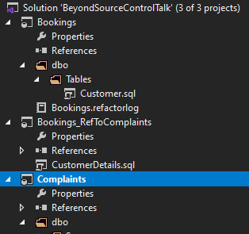
What is a Database Project
Notes:
What is happening under the hood when you open up a Visual Studio solution and see something like this screenshot?
SECTION TIME: 13 mins

Slide 5
What is a Database Project?
.sql
.xml
Build process
Database
.sql
.sqlproj
.dacpac
Deploy
.sql
.sql
.sql
.sql
.sql
.sql
Notes:
So what is a database project, the first thing to realise is it’s not a database
Really it’s a collection of files, mostly .sql files but with some other file types as well.
These files can be edited using management studio, Azure Data Studio, even notepad, but best to use Visual Studio to get the full benefits
Visual studio can trigger a build to a dacpac file, which is the result of the build.
Dacpac holds the schema definition of the project
A publish option triggers a build, and then a deploy from the dacpac to a database.
Other options for build/deploy: powershell, command line etc. Recommend using these for the automation/CI/CD goodness
But usually work through Visual Studio

Slide 6
Core Principals
Always code in Visual Studio
Use the interface where possible
Rename
Change schema
Use CREATE not ALTER
Notes:
First point looks like I’m repeating myself but even working within VS it is tempting to code in Management Studio/ADS and copy that code into Visual Studio, always causes more headaches and does not let the tool help you.
Similarly the tool offers other assistance if you work through the interface. For instance when renaming an object. Make sure you do this where possible, let the tool help you.
Working with a code base, not writing scripts to run against a particular database. So, script all objects as creates and let the deploy process decide whether it needs to be a create or an alter at point of deployment.

Slide 7
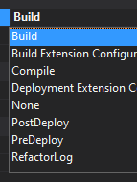
Standard Database Objects
.sql files
File name ≠ object name
Template type ≠ object type
Object behavior depends on
Script
Build action property
Notes:
Tables, views etc.
These are the initial create scripts
At creation you name the object and select the object type but these can be changed
Object selected at creation gives template, name of file is just the name of the file
Key things from script: object name and type
Build actions: Only Build, Refactor log, PreDeploy, PostDeploy, and None matter

Slide 8
Unusual Objects
Users, logins, linked servers etc.
Always deploy to a db
Don’t do it just because you can
Discuss with wider team
Have a good reason
Notes:
There are also more unusual objects you can choose to include
Some of these can live in scripts and even have their own templates
Always need a database to deploy to, even if the project only contains server level objects
Always need a good reason to include these
Established best practice says this is DBA responsibility, adding them to the project makes them Dev responsibility
Not opposed to throwing out established best practice, but you should always have a good reason
Also you will need to convince the DBA
Sometimes you need to include them to make the project build
e.g. service account needs explicit permissions on some objects

Slide 9
Pre/Post Deploy Files
Run at the start/end of deployment
Usually used for static/lookup data
Can be used for other things
Way to include SQL Agent jobs etc.
Only one of these per project
Notes:
Two of the specialist build actions
Hopefully familiar with these, but if not they are scripts that get appended to the start or end of the generated deployment script.
Usually used with merge statements to populate some tables with a known set of data
If your solution needs some specific SQL Agent jobs then set up a script to drop and recreate them
Only 1 pre/post deployment script per project
Project will not allow more than one script with each build action (sets others to None)

Slide 10

Pre/Post Deploy Files
Uses SQLCMD
Can reference other scripts
Get creative with variables
Notes:
As I said, these append to the deployment script generated using SQLCMD language
Therefore these scripts can also use SQLCMD code esp. references to other scripts and SQLCMD variables
References to other scripts let you split code out e.g. 20 static tables but don’t want 20 merge statements in 1 script
References to other scripts can and should be relative, should be inside source control repo, does not have to be inside the database project
Example belongs in a pre-deployment script

Slide 11
Refactor Log
Key part of the code
Tracks renames/schema changes
Always use the interface!
E.g. deployment will rename CustomerIF to CustomerID
Notes:
Last specialist deployment action
Automatically created XML file
Used at point of deployment to decide is something a rename or a new thing
Key point, if renames aren’t captured here the deployment script sees them as different objects
Database will keep a table of where in the refactor log the database is currently at and skip everything before that

Slide 12
Code Organisation
Folder structure
Discuss as a team!
Triggers, extended properties etc.
These can be in separate scripts
Rename things
Notes:
Because everything is a .sql file in a folder structure, you can rearrange the folder structure
Folder structure examples: keep schemas at the top of your schema folder, keep all sub-procedures called by a main proc in the same folder, add subfolders to the Security folder
Objects that hang off other objects: Triggers, extended properties etc. Default/stanadrd is to have them in the same script as the parent, but don’t have to.
e.g. create new file called TableA_Triggers, now you know that table has triggers by looking at the file structure
If you are flagging several things with an extended property, make a file that has that extended property a number of times
Things to make future you (and anyone else who works on the project) grateful
????????????????
???Questions???
????????????????
TIME: 43.15

Slide 13
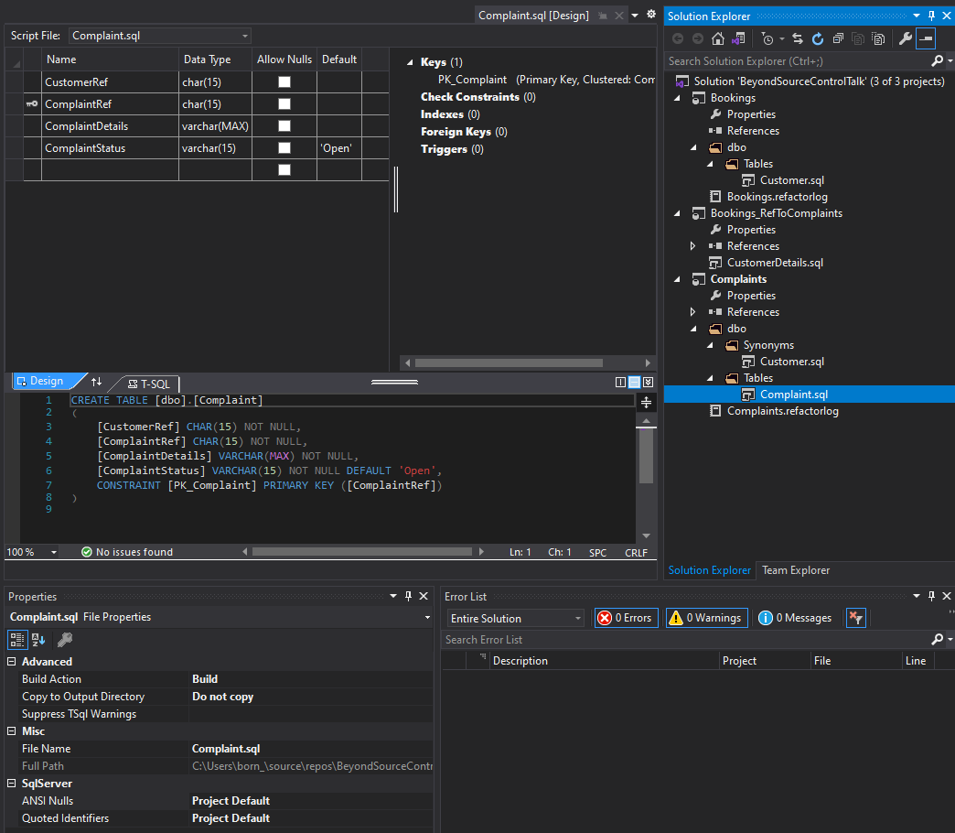
Extra Coding Features
Notes:
Look at some of the nice stuff that helps you out with your coding when you work in visual studio
SECTION TIME: 5 mins

Slide 14
Quality of Life Improvements
Rename/refactor
Use interface
Propagates through solution
F12 – jump to other objects
Notes:
Another reason to use the interface
Example of CustomerIF to CustomerID
Highlight an object in some code and hit F12 – open the script that defines that object
Really nice for code investigations – when you’re looking at a stored proc and it calls another 5 procs, no need to go hunting for their scripts

Slide 15
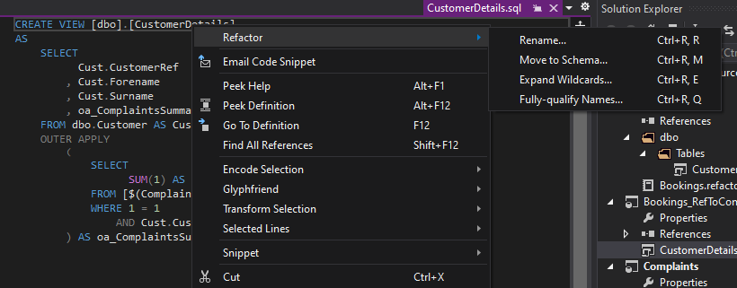
Rename/Refactor

Slide 16
Scripts Not Objects
Comments on anything!
Tables
Schemas etc.
Capture encrypted procs etc.
Notes:
Continuing the theme of projects are not databases, scripts are not objects:
You can add comments to any script
Will not appear in your database if you script the object definition but will be there in visual studio forever
If you encrypt your code you will always be able to view the unencrypted version in visual studio

Slide 17
Validation
Scripts validate with IntelliSense
Object references
Double click to jump to problem
Can suppress errors
Project + script level
Notes:
Finally we get some really nice validation tools in Visual Studio
Errors for the project/solution appear in the error tab as soon as you make a change
- can see if you have broken another script with your code
Double click in the error tab to jump to the error
Idea that this is not a db, it’s a project and the whole project has to work
Suppress errors through your properties windows

Slide 18
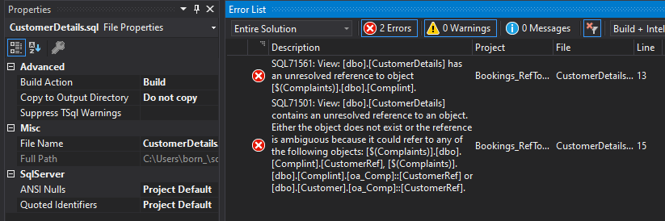
Validation Example
Notes:
This is the error number to use to suppress an error
Not always as bad as it looks – 1 issue can generate many errors
E.g. here we have 2 errors generated by 1 issue
Suppressing errors is the nuclear option.
??????????????????
???QUESTIONS???
??????????????????
TIME: 38.45

Slide 19
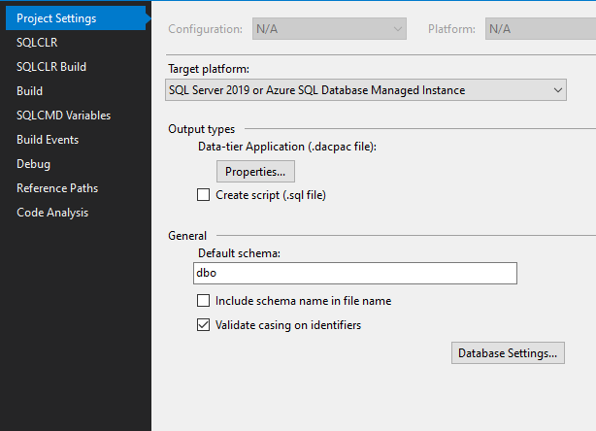
Settings and Deployments
Notes:
Looking at a few of the project properties/settings and the deployment options open to you.
This is an area where I will mostly be making you aware of stuff and leaving you to investigate more
SECTION TIME: 6 mins

Slide 20
Project Properties - Errors
Suppress error types
Add extra warnings
e.g. warn on SELECT *
Set warnings = errors
Notes:
Continuing from the errors: can suppress errors at a project level – do this through project properties
Another possible warning – use reserve words in names, avoid LIKE predicates that start with wildcard (performance) etc.
Warning = error good: people ignore warnings and stored proc only throws a warning if it references an object that does not exist
Maybe this is ok with you because you have a design pattern that uses this

Slide 21
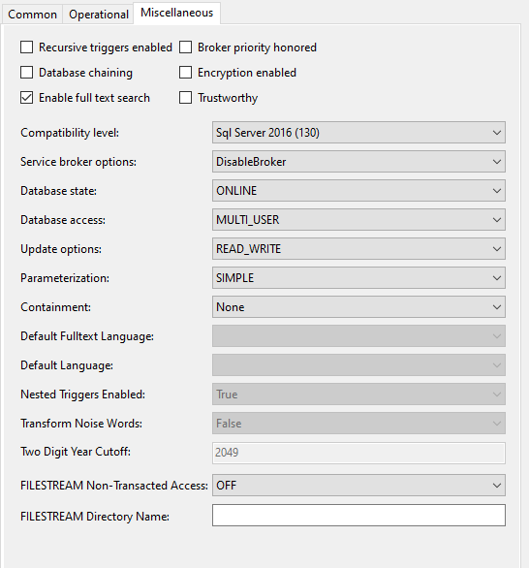
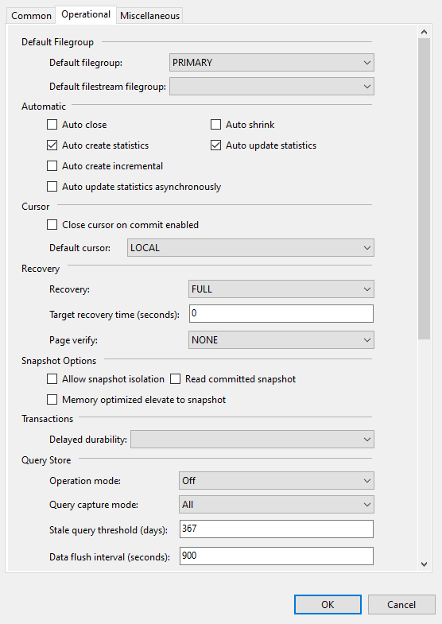
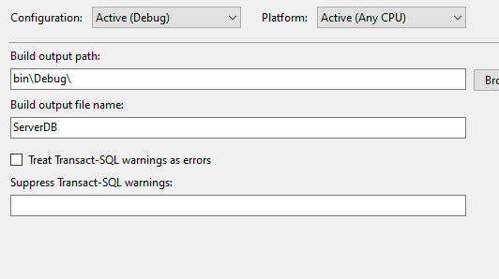
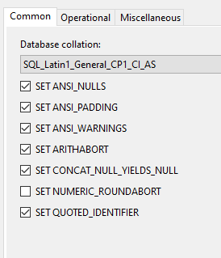
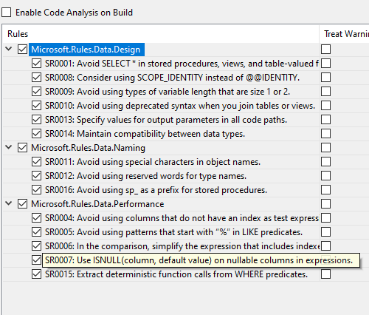
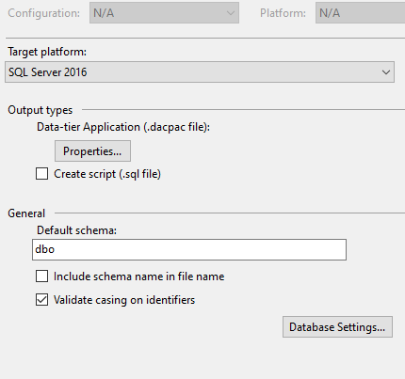
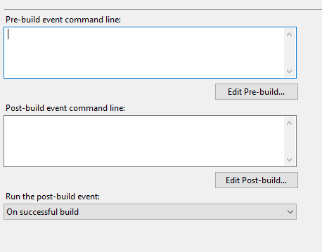
Project Properties - Other
Database settings
SQLCMD variables
SQL version
Notes:
Database settings:
- Recovery model
- Enable service broker
- single/multi/restricted-user access
Etc.
Again, should usually leave this up to the DBA
SQLCMD is the language the deployment scripts are generated in
So can use the variables throughout your scripts
e.g. the ClearDB variable from the pre-deployment script earlier, needs to be created in the project properties
SQL versions need to be correct at point of deployment for the server you deploy to
Start to click through screenshots
Whole load of other things you can do, this is one area where I’m making you aware of something and leaving it for you to explore

Slide 22
Deployments
Set:
Variables
Connection string including db name
Notes:
This is when you take your project and push it out to a server somewhere
Can use variables to make the deployment behave differently for different environments/deployments
Can deploy same db several times with different names e.g. feature branches/performance improvements and baseline

Slide 23
Deployments
Many options
Include db settings or not
Drop objects (destructive deployment)
Exclude object types
Notes:
Includes db settings by default so usually turn these off
Database settings examples: recovery model, filegroups, database access model
- like the logins etc. leave this up to the dba
Drop objects drops things on server but not in project
The dream is to be able to turn this on with confidence
Needs agreement outside of the team that nobody is creating things on that database apart from you
Exclusions e.g. users if needed to include to make some code validate, but do not want to actually deploy (dba controls users)
Again, lots of options so will leave it to you to explore
??????????????????
???QUESTIONS???
??????????????????
TIME: 32.30

Slide 24
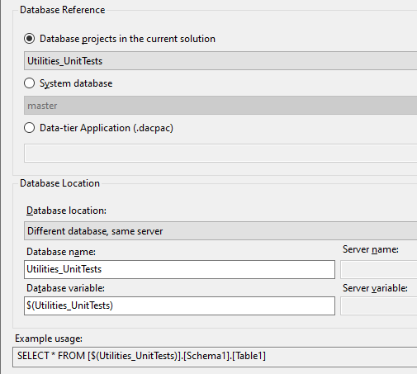
Other Database References
Notes:
This section about references to other databases from your project
This is where you want to refer to an object in another database in some of your code
You can see in this screenshot you can do this by:
- referring to other projects in this solution directly
- referring to master/msdb databases
- referring to a dacpac – allows references to projects in another solution
SECTION TIME: 4 mins

Slide 25
Things to Note
.dacpac file references are relative path
All references refer to .dacpac files
Even master/msdb
Notes:
Path is relative therefore:
Target dacpac should be inside your source control repo
References to other projects in the same solution are looking in the bin folder for that project
Master/msdn = system databases. These are references to dacpacs in the visual studio folder on your local machine

Slide 26
Common Gotchas
Rebuild to refresh references
Include all dependent references
Change to SQL version
Breaks system databases
Recreate reference
Notes:
Changes only propagate to other projects after rebuild
Complaints references Bookings references Customers, Complaints must also reference Customers
Change SQL version in setting means system databases being referred to are now the wrong version
??????????????????
???QUESTIONS???
??????????????????
TIME: 28.45

Slide 27
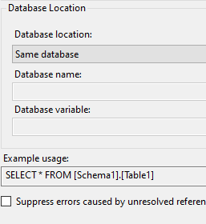
Same Database References
Notes:
References leads us to the biggest overlooked feature in database projects
What makes me evangelical about their use
SECTION TIME: 13 mins

Slide 28
How They Work
Complaints
Code
Complaints Tables
Complaints Tables
Notes:
In this example, project called complaints tables
Second project called complaints
With a same database reference to Complaints tables
This effectively means Complaints now includes all of the objects in Complaints tables…

Slide 29
How They Work
Code can reference Tables
But not the other way
ComplaintsCode dacpac:
ComplaintsCode
ComplaintsTables
Complaints
Code
Complaints Tables
Complaints Tables
Notes:
In this example, project called complaints tables
Second project called complaints code
With a same database reference to Complaints tables
This effectively means Complaints code now includes all of the objects in Complaints tables…
Dacpac for complaints code includes
All of the code objects from complaints code
But also all of the tables in complaints tables
Neat feature but why do we really want to use it?
This is most commonly used for solving the circular references problem

Slide 30

Circular References
Complaints
Bookings
Notes:
So I’ll take you through that problem and how the solution works under the hood.
This arises because we have two databases on the server
The Complaints database has a reference to an object in the Bookings database

Slide 31
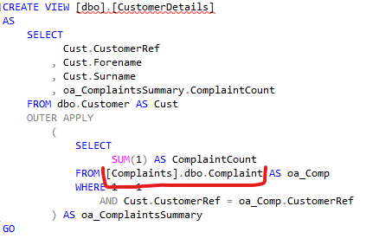
Circular References
Complaints
Bookings
Notes:
Most common use is to solve the circular references problem
This arises because we have two databases on the server
The Complaints database has a reference to an object in the Bookings database
And the bookings database has a reference to an object in the complaints database

Slide 32
Circular References
Complaints
Complaints
.dacpac Complaints
Bookings
Bookings
.dacpac Bookings
Notes:
In projects, our instinct is to create one project per db and set up references to each other, but this fails
The failure is because the references are actually to dacpacs…

Slide 33
Circular References
Complaints
Complaints
.dacpac Complaints
Bookings
Bookings
.dacpac Bookings
Notes:
In projects, our instinct is to create one project per db and set up references to each other, but this fails
The failure is because the references are actually to dacpacs…
And each dacpac is the result of a build of a project
But neither dacpac can build because they need the other dacpac to be present first – visual studio recognizes this and refuses to allow the circular reference
So, we wipe that as a possible solution…

Slide 34
Circular References
Complaints
Complaints
Bookings
Bookings
Notes:
Instead we create a project called complaints
And a project called bookings
And set up a database reference from Complaints to Bookings
And create the synonym in the Complaints project…

Slide 35
Circular References
Complaints
Complaints
Bookings
Bookings_
CircularRef
Bookings
Bookings
Notes:
Then we set up a project called Bookings_CircularRef, and create a same database reference to the Bookings project…
Which attaches that virtual version of Bookings to the CircularRef project

Slide 36
Circular References
Complaints
Complaints
Bookings
Bookings_
CircularRef
Bookings
Bookings
Notes:
Then we set up a project called Bookings_CircularRef, and create a same database reference to the Bookings project…
Which attaches that virtual version of Bookings to the CircularRef project
Note that the CircularRef project is currently empty, but has the ‘virtual’ Bookings project attached to it
We can the create a different database reference to the Complaints project
And create…

Slide 37
Circular References
Complaints
Complaints
Bookings
Bookings_
CircularRef
Bookings
Bookings
Notes:
And create… the view from the Bookings database in this CircularRef project.
When deploying, we deploy the Complaints project and the Bookings_CircularRef project. Not the bookings project unless you need to deploy that first to make all of the deployment scripts work.
Now move on to a few other use cases

Slide 38
Use Case 1: Tests
Prod Complaints
Complaints
Main database
Database + unit tests
Deploy
Complaints > Live
Tests > Dev
Complaints_
Tests
Unit tests
Dev Complaints
Complaints
Notes:
Brief explanation of tSQLt
- installs functions
- views
- SQLCLR assembly
Obviously don’t want to deploy unit tests or framework to live or UAT
So, create a Complaints project
Create a Complaints_Tests project to hold the unit tests and the tSQLt framework
With a same database reference to Complaints
Now, can deploy Complaints to Live
And Complaints_Tests to Dev

Slide 39
Use Case 2: Re-use Utilities Project
Start of breaking up Monoliths into Lego bricks
Utilities project example
Holds useful code objects
E.g. tally table and date list functions
Notes:
Monolith – big database filled with many things. Maybe has some code you want to re-use elsewhere

Slide 40
Use Case 2: Re-use Utilities Project
Bookings
Utilities
Utilities
Complaints
Utilities
Notes:
Start with the Utilities project
We also have our Bookings project that wants the Tally table function
So add a same db reference to our utilities project
And the Complaints project wants the Date list function
So add a same db reference to the utilities project
Allows us to modify the code in utilities and have it propagate out to other projects – similar to C# class library

Slide 41
Use Case 3: Common Foundations
Example company
Managed travel software
Database
Common code base
Bespoke elements
Notes:
We work for a company who produce managed travel software
So new client comes to us and says we want to set up a travel database, and have you manage the database
Each client wants something similar but different
Look for a similar client, copy their db, start hacking, bolt things on, slap on some duct tape, tie some things together with string, not very elegant.
Database projects offers us a better way of managing this to give us a common code base for each client, and be able to add bespoke elements on top of that.

Slide 42
Use case 3: Common foundations
Components
Core - Bookings
Loyalty
Complaints
Etc.
Notes:
To do this we create a number of components in different projects, similar to our Utilities project
We have a core component that handles bookings, because everyone wants that
Loyalty component for clients who want to offer rewards points, not every client will want this but quite a few will
Complaints component because some clients will want to manage complaints with us, but others will use their own complaints software

Slide 43
Use Case 3: Common Foundations
Core
BigHolidayLtd
Loyalty
Core
Complaints
Loyalty
Complaints
Notes:
New client, BigHolidayLtd
obviously they need the core
Also requests the Complaints system
Later wants the Loyalty points program as well, so we just add another reference
Once we have one or more of our base components, we can add the custom stuff…

Slide 44
Use Case 3: Common Foundations
Core
BigHolidayLtd
Loyalty
Core
Complaints
Loyalty
Complaints
Notes:
Maybe we find something that we think should be part of the Core or the Loyalty projects:
Add them to the relevant project and they automatically propagate out to all other clients, no copying from one to the other.
This is a simplified version of the system
Likely the actual version will look more like this:

Slide 45
Use Case 3: Common Foundations
BigHolidayLtd
Loyalty
Core
Complaints
Loyalty
Utilities
Utilities
Core
Utilities
Utilities
Utilities
Complaints
Core
Core
Notes:
Because the Loyalty and Complaints systems are also built on top of the core system
Maybe even more complicated if you have something like a Utilities project that everything references.
But you don’t really need to track these references like this
About to move on to some tips
??????????????????
???QUESTIONS???
??????????????????
TIME: 15.15

Slide 46
Tips
Deployed project controls:
Properties
Pre/post-deployment scripts
Can chain these
Notes:
Pre-post deployment scripts chaining:
Remember can reference other scripts and those scripts get included in the parent on deployment/execution
This chains, so if Complaints post-deployment script references several other scripts (to populate several tables with static data) you can reference the Complaints post-deployment script from the NewClient post-deployment script, and scoop all of those static data scripts.
SECTION TIME: 7 mins

Slide 47
Tips
Cannot override objects
Instead:
Split tables out
Reference Views/Procs in outer project
Notes:
BigHolidaysLtd cannot change a view in Core
Instead
If you want to add new columns to a table, add a new table
If you want to change a view/proc, create a new object and call the object in core
Explain further in next few slides

Slide 48
Split Tables
complaints.ComplaintDetailsBigHoliday
complaints.ComplaintDetails
Notes:
Want to add some extra columns to ComplaintDetails table just for one client…
TIME: 12.45

Slide 49
Split Tables
complaints.ComplaintDetailsView
complaints.ComplaintDetails
complaints.ComplaintDetailsBigHoliday
Notes:
Want to add some extra columns to ComplaintDetails table just for one client…
Create new table
Maybe add a view over the top to join them, to let you reference them as if they were one table
TIME: 12.45

Slide 50
Reference Views/Procedures
complaints.ResolveComplaintBigHoliday
complaints.ResolveComplaint
complaints.ComplaintDetails
complaints.ComplaintDetailsBigHoliday
Notes:
What if we have a ResolveComplaint procedure that updates the ComplaintDetails table and returns some success marker
We need the actual resolve complaints process to also update or make use of some of the fields in our custom table for Customer A…
TIME: 11.15

Slide 51
Reference Views/Procedures
complaints.ResolveComplaintBigHoliday
complaints.ResolveComplaint
complaints.ComplaintDetails
complaints.ComplaintDetailsBigHoliday
Notes:
What if we have a ResolveComplaint procedure that updates the ComplaintDetails table and returns some success marker
We need the actual resolve complaints process to also update or make use of some of the fields in our custom table for Customer A…
This can work by cutting out the original proc altogether, copy the code to the new proc
But what if we e.g. find a bug in the original proc?...
TIME: 11.15

Slide 52
Reference Views/Procedures
complaints.ResolveComplaintBigHoliday
complaints.ResolveComplaint
complaints.ComplaintDetails
complaints.ComplaintDetailsBigHoliday
Notes:
What if we have a ResolveComplaint procedure that updates the ComplaintDetails table and returns some success marker
We need the actual resolve complaints process to also update or make use of some of the fields in our custom table for Customer A…
This can work by cutting out the original proc altogether, copy the code to the new proc
But what if we e.g. find a bug in the original proc?...
Better to reference the original proc from the new one, and add some extra logic to also take care of updating the Customer A custom table
TIME: 11.15

Slide 53
Referencing a project that’s part of another database
Bookings
Utilities
Utilities
Complaints
Notes:
Finally, I want to talk you through an issue you may find
In this scenario Bookings has a same database ref to Utilities
Complaints wants to reference some objects in Bookings, including one of the Utilities objects
This is actually…
TIME: 10.15

Slide 54
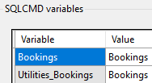
Referencing a project that’s part of another database
Bookings
Utilities
Utilities
Complaints
Notes:
Finally, I want to talk you through an issue you may find
In this scenario Bookings has a same database ref to Utilities
Complaints wants to reference some objects in Bookings, including one of the Utilities objects
This is actually…
A reference to the Utilities project, and we would handle it as a different database reference
At point of deployment we would just put in the same name for the Bookings and the Utilities databases
TIME: 10.15

Slide 55
Issue – Multiple References to a Project
Bookings
Utilities
Utilities
.dacpac Utilities
Complaints
Utilities
Notes:
But what about if Complaints also already includes Utilities
We make the usual ref to Bookings
Make a ref to Utilities, but it fails…
TIME: 8.45

Slide 56
Issue – Multiple References to a Project
Bookings
Utilities
Utilities
.dacpac Utilities
Complaints
Utilities
Notes:
But what about if Complaints also already includes Utilities
We make the usual ref to Bookings
Make a ref to Utilities, but it fails…
Again this is because the ref is actually to the Utilities project
Visual Studio doesn’t allow multiple references to the same thing from the same project
But…
TIME: 8.45

Slide 57
Issue – Multiple References to a Project
Bookings
Utilities
Utilities
.dacpac Utilities_
Bookings
.dacpac Utilities
.dacpac Utilities_
Complaints
Complaints
Utilities
Notes:
But…
If we remember all references are references to dacpacs
And dacpacs are just files…
TIME: 8.45

Slide 58
Issue – Multiple References to a Project
.dacpac Utilities_
Bookings
Bookings
Utilities
Utilities
.dacpac Utilities
.dacpac Utilities_
Complaints
Complaints
Utilities
Notes:
But…
If we remember all references are references to dacpacs
And dacpacs are just files…
We can copy the dacpac and have Complaints reference different copies of the same dacpac
This copy can be done automatically, project properties>build events>Post build event command line
??????????????????
???QUESTIONS???
??????????????????
That’s the end of the last section…
Bonus: common deployment issues
TIME: 8.45

Slide 59
Deployment Issues
Something wrong in the code
Should get an error message
Referenced files don’t exist
Pre/post deployment scripts
Notes:
Usually code errors are something to do with aggregations/missing group by columns
Note: anything before this will have deployed
TIME: 8.00

Slide 60
Deployment Issues
Changes to [X] may introduce runtime errors in [Y]
Must include [Y] in your project
Or drop [Y] on the server
Notes:
Y is e.g. a view on the server and not in your project (for whatever reason)
X is e.g. a table referenced by Y. It exists on the server and in your project
Deployment can see that by changing X, you may break Y
Cannot validate Y because it is not part of the project
TIME: 6.15

Slide 61
Summary
Projects are not databases
Always work in Visual Studio
Lots of extra coding features
Project + deployment settings
Use same database references
Notes:
That’s the end of the last section…
I know I’ve thrown quite a bit of information at you, so to quickly summarise what we’ve talked about:
For the final time: projects are code bases not databases
Take advantage of the cool stuff you get with visual studio and work in the tool
Explore the different project settings and deployment options
Use same database references to handle different versions deploying out to different environments, and to re-use code in a more elegant way
TIME 5.00

Slide 62
Any Questions?
Email: chris.johnson.0120@gmail.com
Blog: www.chrisjohnson120.com
GitHub: https://github.com/ChrisJohnson0120
Please get in touch
Notes:
Thank you to Ben and William for organising the event
All the hard-working volunteers behind the scenes
Rob for mentoring me, the talk is at least 10 times as good as it would have been without him
Thank you all for listening, I hope you’ve learned something, ad I hope some of you go away and have a bit of an explore and see what uses you can find for db projects.
Contact details are on the screen, reach out if you have any further questions, or need some help, or if you want to let me know how you’re getting on exploring the tool for yourself.
Have a great weekend and hopefully we’ll all be back to doing this in person sometime soon.

